Slide 1

Quantitative Research in Political Science How to Apply the Classical Toolbox
Giuseppe Carteny
Postdoctoral Researcher
Department of European Social Research
University of Saarland
UdS SoSe2025 - Class 1 (2025.04.07)

Slide 2

Who am I?
Dr. Giuseppe Carteny
Postdoctoral researcher (Wissenschaftlicher Mitarbeiter) at the chair of Prof. Dr. Daniela Braun since 2023
Postdoctoral researcher at the Mannheim Centre for European Social Research (MZES) from 2021 to 2023
PhD in Political Studies at the University of Milan, and Msc and Bsc in political science at the LUISS University of Rome
I research gender-related issues - and how far-right is twisting these - for the UNTWIST project…
…but also party competition, political attitudes and behaviour in Europe and East Asia using public opinion surveys, experts’ data, party manifestos,…

Slide 3
Who am I?
Contacts
Office: Building C5 4, Room 1.02
Office hours: tbd
Email: giuseppe.carteny(at)uni-saarland.de
Teams: gica004(at)uni-saarland.de
Materials: Teams (I’ll create the space after this lesson)

Slide 4
Today‘s seminar
Logistics and rules
Why this course?
Basic notions
Assignment

Slide 5
Logistics and rules

Slide 6


Content of the course
How to Apply the Classical Toolbox
First six classes
Giuseppe
How to Analyse Digital Content for Political Science Research
Second six classes
Alexander

Slide 7
Content of the course
Class 1 – Intro: Motivation, materials, aims, requirements, …
Class 2 – The first bricks: Data structures, statistical concepts, revising R basics, …
Class 3 – Going multivariate! Generalised linear models, and the bread and butter of multivariate methods (i.e., the linear model)
Class 4 – Make your analyses understandable! Quantities of interest and how to visualize them
Class 5 – How to deal with categories and counts: Probit, Logit, & friends
Class 6 – Outro: Review/How to apply these methods to your research questions
Syllabus
COMING SOON

Slide 8
Structure of the course
Today, a bit more
Today, a bit less
Lesson
(45/60 min)
Hands-on session
(30/45 min)
Assignment

Slide 9

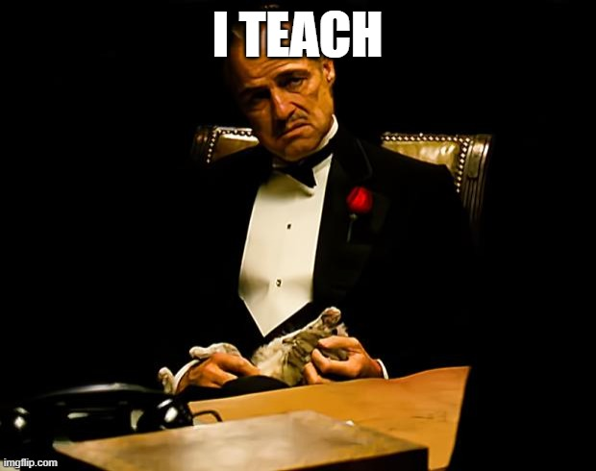

Rule #1

Slide 10


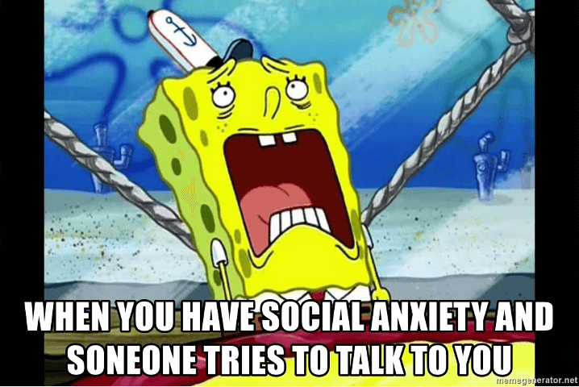

Rule #2
This is a seminar
You must interact

Slide 11

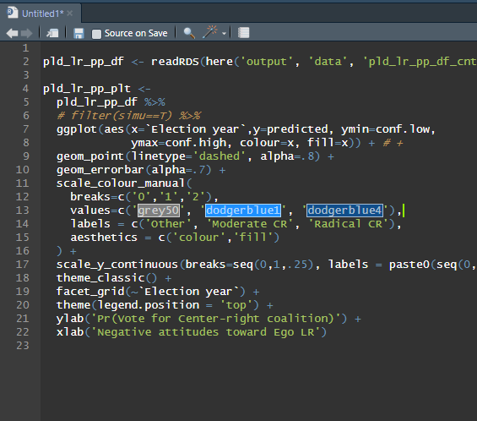



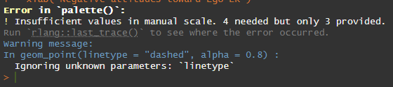

Rule #3

Slide 12




Rule #4

Slide 13
Why this course?

Slide 14
Why this course?
Why did you choose it?
There are no wrong answers!

Slide 15
Why this course?
We want you to be able to…
systematically analyse the social and political world
produce informed, reliable, and valid insights about it, for you and others

Slide 16
Why this course?
You might want to become a political scientist…

Slide 17
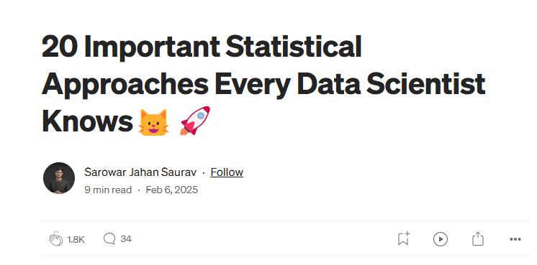
Why this course?
You might want to become a political scientist…
… but even if you don’t want to be a researcher (and you want have a normal life, with a well-paid job)… you might still want to learn these skills!
Bayesian Inference Maximum Likelihood Estimation (MLE) Hypothesis Testing (t-test) Analysis of Variance (ANOVA) Principal Component Analysis (PCA) Factor Analysis Cluster Analysis (K-means) Bootstrapping Time Series Analysis (ARIMA) Time Series Analysis (ARIMA) Multivariate Regression (Multiple Linear Regression) Ridge/Lasso Regression Logistic Regression Mixed Effects Models Nonparametric Tests Monte Carlo Simulation Markov Chain Monte Carlo (MCMC) Robust Regression Copulas Generalized Additive Models (GAMs)
Foundational for:
Data science Machine learning Market research Brand management Digital journalism Cyber security Legal analysis Financial planning
and more...

Slide 18

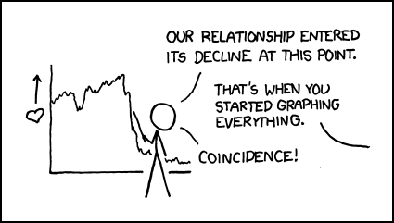

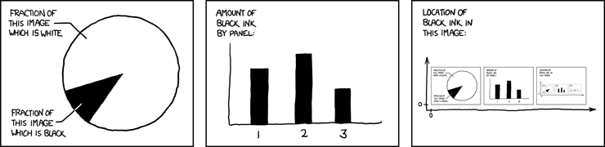
Why this course?
THINKING CLEAR
WITH DATA
CLEAR ANALYSES
OF YOUR DATA

Slide 19
Why this course?
Politically relevant questions
Some can be addressed with quantitative methods
Others cannot
Are democracies less prone to war?
Which are the determinants of war?
Are young voters more progressive than older ones?
Are politicians more negative online than offline?
Which parties focus on which topics?
Are parties becoming more polarised over time?
Is Elon Musk a fascist?
How do we know our results are accurate?
Is Elon Musk a fascist?
Are far-right actors spreading dis/misinformation more online than other actors?
Who believes in conspiracy theories?
Are Europeans becoming more Eurosceptic?

Slide 20
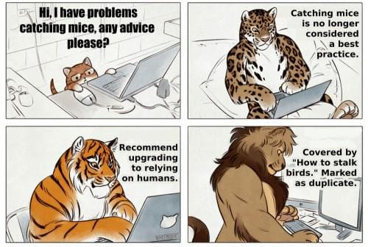
Why this course?
What you can expect:
Learn how to develop a research design
come up with proper research questions
select proper data and methods
develop robust analyses
produce understandable, and substantially informative insights
Learn how to do it in R
It’s free and open-source
Has a myriad of packages for different tasks
It has a strong, interdisciplinary user community
Has a steeper learning curve … but it will repay you with flexibility and power

Slide 21
Why this course?
What you can expect, more specifically is:
To create analytical models
To operationalize concepts - translating concepts into variables that can be studied through data.
To import, use, explore, wrangle existing datasets about these topics
Coding good practices
To learn the main aspects of statistical modelling
Produce informative summaries and visualizations of your quantities of interest

Slide 22
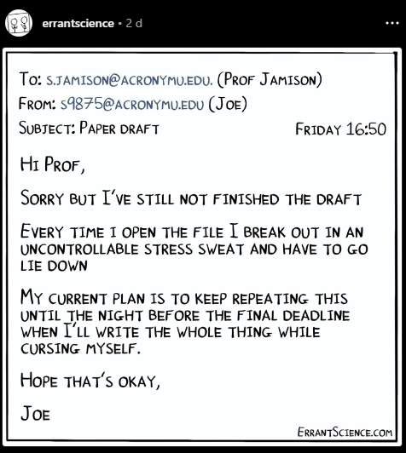
Why this course?
To do so, what we need is…
Abstraction
Practice
Formulas
Patience
Practice
Practice
Practice
Practice
Practice
Practice
(few, no worries)

Slide 23
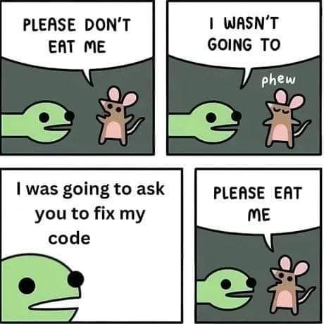
Why this course?
What you should not expect:
Learn how to develop models for causal inference or experimental data
Probability theory
Learn how to collect primary data – surveys, scraping, ….
Learn how to write an essay/term paper
That I’ll fix your R code (but I’ll tell you how to do it)

Slide 24
Basic notions
and where to find them

Slide 25
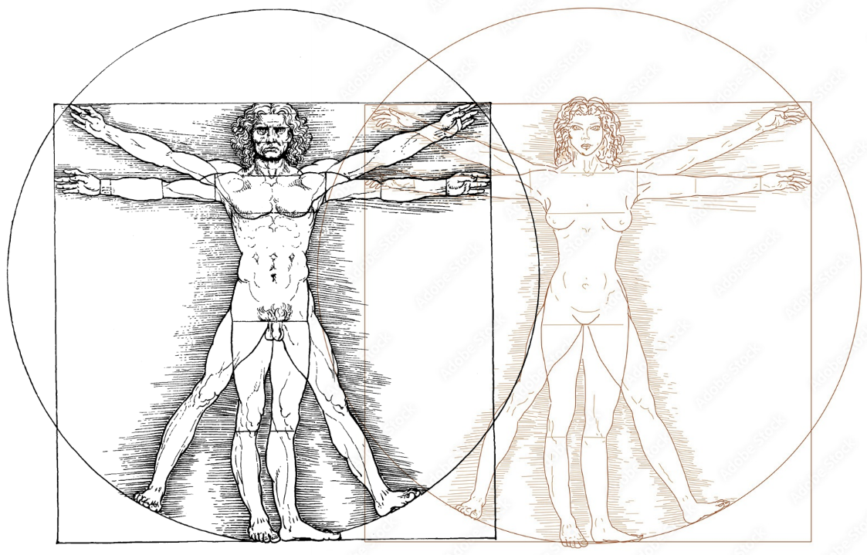

Model
Basic notions:

Slide 26
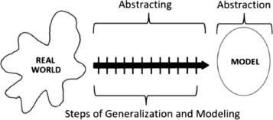
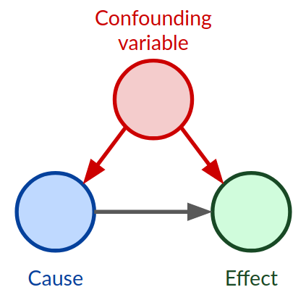
Basic notions: Model
One of the main goals of science is generalisation about populations
For generalising we need to abstract from the real phenomenon
We need a theory that allows us to identify relationships between relevant features
Some features are constant other vary – but we are interested in the latter, which are indeed called variables

Slide 27
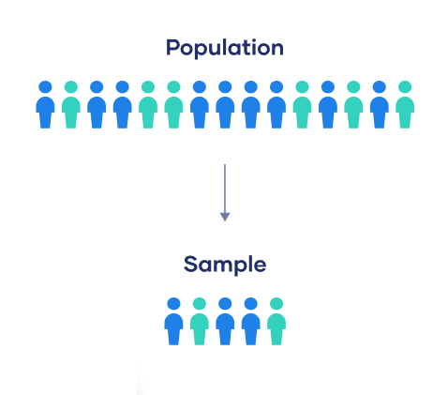
Basic notions: Population
The population is the social system about which you want to make some inferences
The largest component of scientific inference* – in the social sciences
There are different social systems – a country, a party system, an election, a war,…
They usually contains certain features that are either known or estimable
But important elements remain unobserved and indeed unobservable
*
BIAS

Slide 28
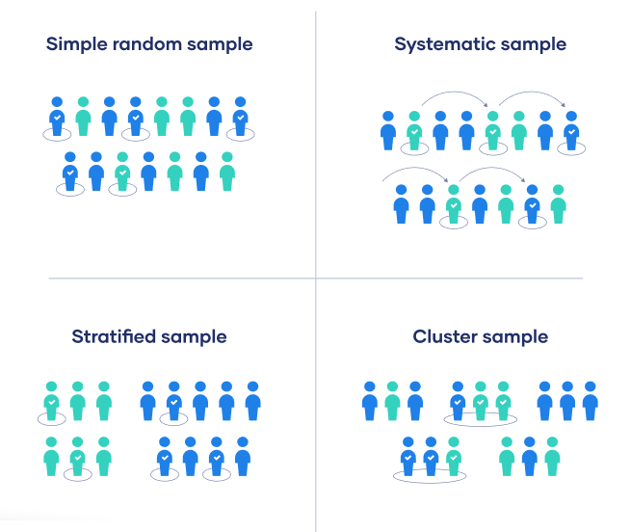
Basic notions: Sample
BIAS
A sample is…
It is a subset of the population – and it is the only thing we actually observe
It should be representative (of some features) of the population
Many ways to obtain it
Simple random sampling
Stratified sampling
Clustered sampling
Quota sampling
…
It is a fundamental concept because it allows us to understand why we need to deal with uncertainty

Slide 29



Basic notions: Observations & variables
Observation
It is a basic unit of analysis and/or measurement
It has some features which vary in the social system (but are constant for her/him/them/…) measured in different ways
Variable
A features of the observation that varies
Is also called random variable since the actual data are randomly produced from the social system and gave some probability to occurr

Slide 30
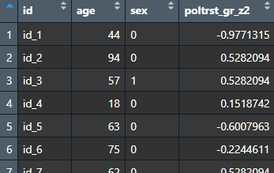
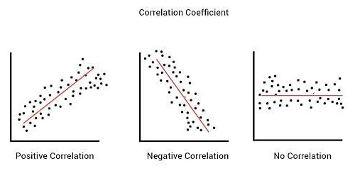
Basic notions: Correlation & Causation
Correlation
… between two features/variables is the extent to which they occur together
You always need variation
You always need a comparison of some kind
It is a general concept which is then translated in a statistical concept.
Correlation is not… Causation
Causation is a change in some features that result from a change in other features
Mostly unobservable- comparison of counterfactual worlds

Slide 31
Assignments
and where to find them

Slide 32
Assignment #1
Start with/Refresh R!
Practice
A platform to practice without installation: https://adp-cvk.quarto.pub/r-for-social-science-data-analysis/
Some basic statistics with R: https://statsandr.com/blog/descriptive-statistics-in-r/
Installation
Are R and Rstudio installed on your computer/laptop?

Slide 33
Assignment #2
Read (a bit)
Resources
See the references!
Bueno de Mesquita & Fowlers (2021) - Chapters 2, 3, and 5
King (1998) – Chapter 1
(I’ll share them via Teams later today)

Slide 34
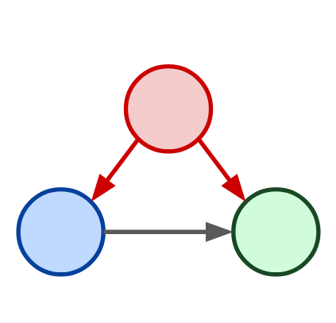
Assignment #3
Start building your Model!
Confounder
Independent Variable
Dependent Variable

Slide 35
Thank you for your attention!

Slide 36
References
Bueno de Mesquita, E., & Fowler, A. (2021). Thinking clearly with data: A guide to quantitative reasoning and analysis. Princeton University Press.
King, G. (1998). Unifying Political Methodology: The Likelihood Theory of Statistical Inference. University of Michigan Press.

